Slide 1

WORLD BANK GLOBAL EDUCATION
EXPLORATORY DATA ANALYSIS

Slide 2

By:
Neel Naik
Prasad Khadatkar
Piyush Nirwan
Shivank Shukla
Saransh Jain

Slide 3

Introduction
Education is very important for personal development as well as for the socio-economic development of our country.
Education is important for living life happily.
It empowers and motivates our mind to conceive the good thoughts and ideas and grow our knowledge day by day.

Slide 4

Data Cleaning
Questions???
What are the parameter which effect Education on broader level ?
Is there any correlation between amount of money spent by Government ?
Why some countries having good Education system and literate labour Force ?
Does Education really affect society if it affect, then How?

Slide 5
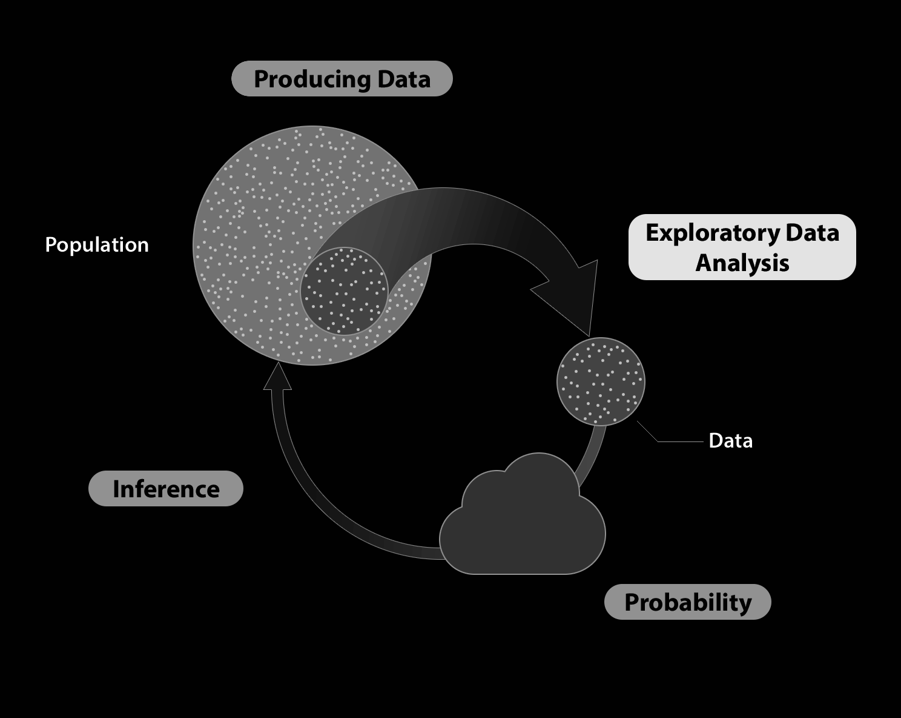
EDA APPROACH
Importing Required Libraries
Loading Datasets
Data Understanding
Data Cleaning
Data Analysis
Data Visualization
Inference

Slide 6


Understanding Dataset
Tables
Columns
Data Quality
Data Selection
Column analysis
Table analysis

Slide 7

We understood that…
Indicators for various parameters of education and economy.
Values of parameters from 1970 - 2015
Discount the columns that are not useful.
Classes w.r.t economy
Correlation b/w spending on education and its outcome
Teachers to student ratio.
Trend change in importance of education

Slide 8
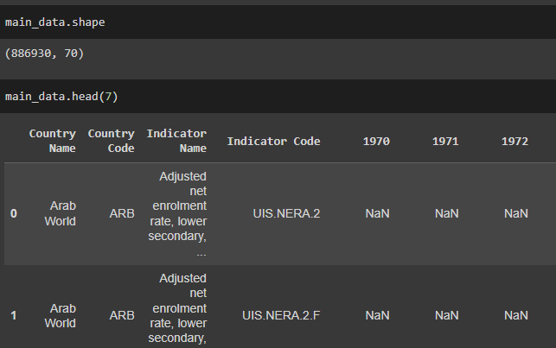
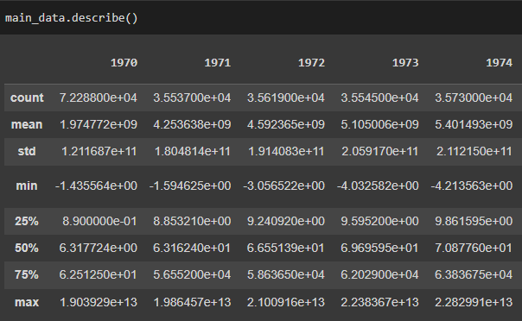
Data Understanding
Using Basic attributes and methods on dataframe for having data insight.

Slide 9

Data Cleaning
Calculating % of null values.
Getting Info. for the columns.
Dropping columns having null values above 90%.
Creating sub-Data frames according to the required info. With the provided Indicators.

Slide 10
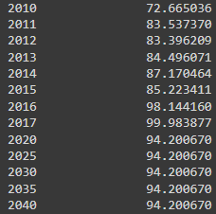
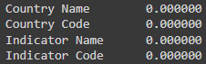
Data Cleaning
Keeping non null values
Removing columns with Null data more than 90%

Slide 11

Data Analysis
Analysis based on the following:
Income group
Region
Big Economies of the world

Slide 12
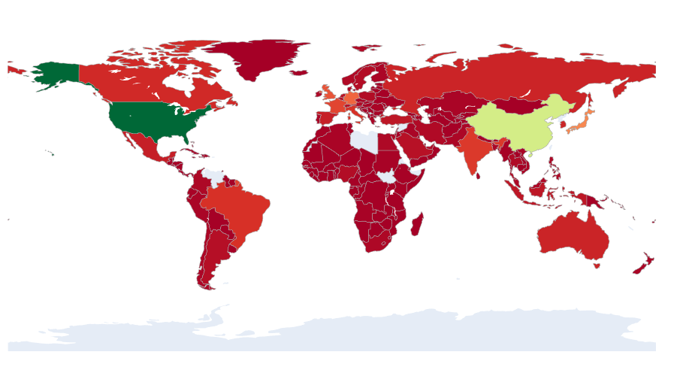
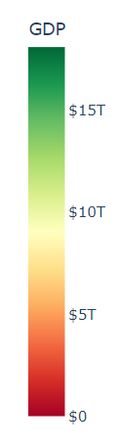
GDP of world on map
Inference: Most of the world having GDP less than $ 3T economy, GDP of INDIA is around $ 3T.

Slide 13
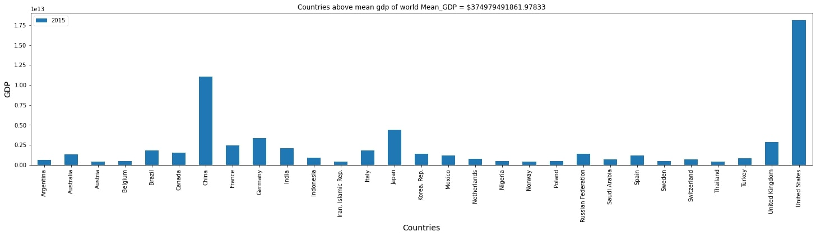
Data Visualization
Countries are having GDP above mean GDP and mean per capita GDP of world, which gives us macro and micro perspective.

Slide 14
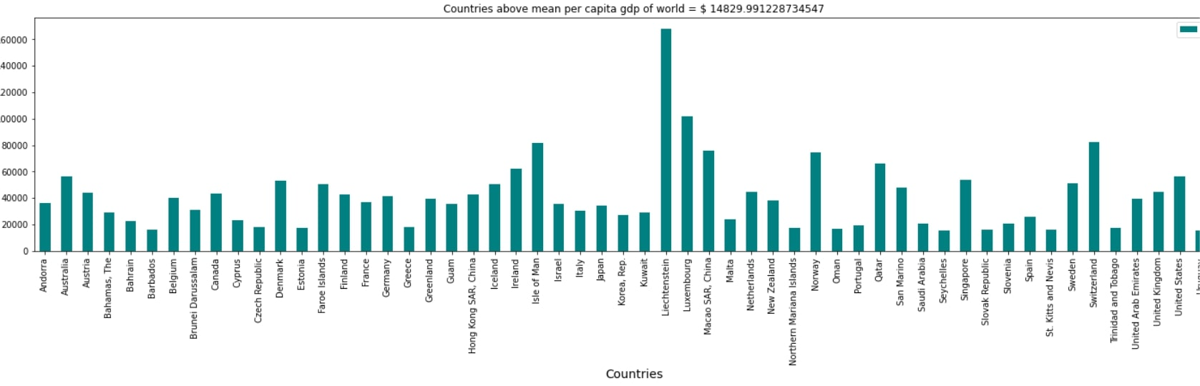
Inference: India’s per capita GDP is below the mean per capita GDP of world despite of the fact we are 5th largest economy of world. Which affects India’s education and population growth.

Slide 15
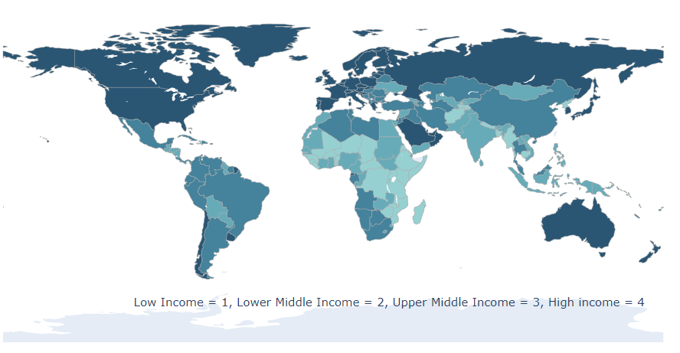
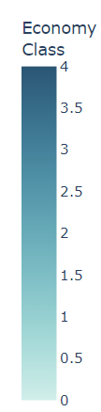
World Economy class distribution
Inference: Europe and Northern countries lies within High Income Group while the Southern and asian countries belongs to upper middle income and lower middle income.

Slide 16
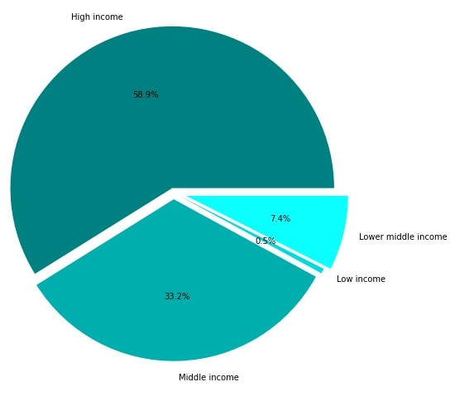
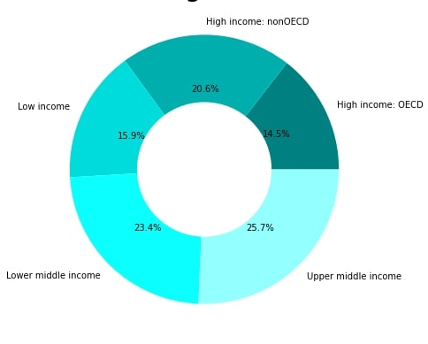
Percentage share of Income group in GDP of World
Composition of world wrt to Income group

Slide 17
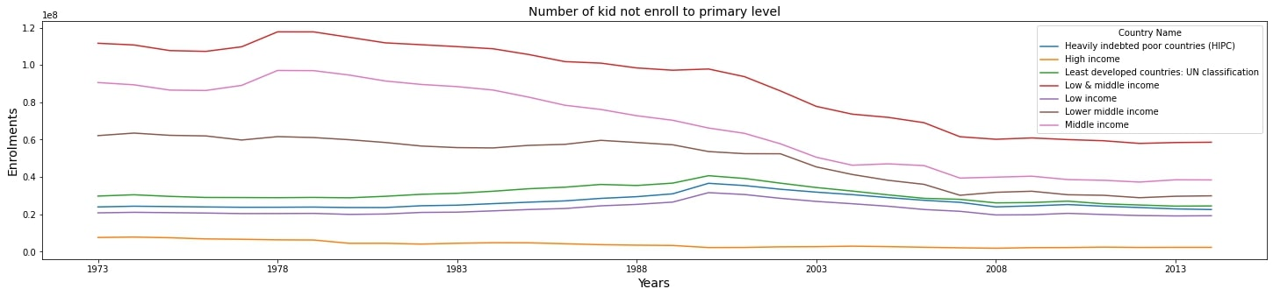
Education EDA
Inference: Number of kids not getting primary education is decreasing over the years, and it is lowest for High income group. The more economical stable the income group is the more they are educated. Education is directly proportional to the money we earn and vise-e-versa.

Slide 18
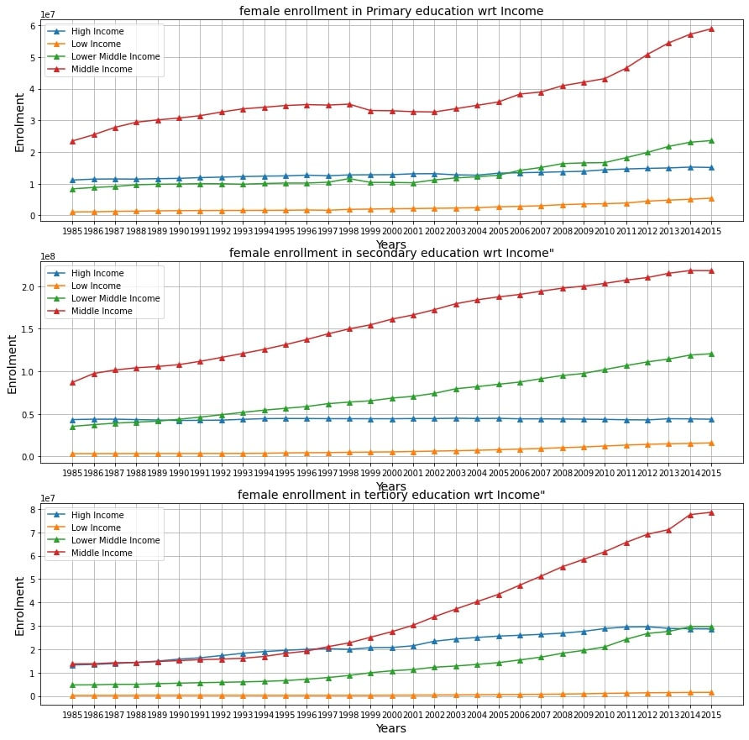
Female Enrolment of various level of schooling for different income group

Slide 19
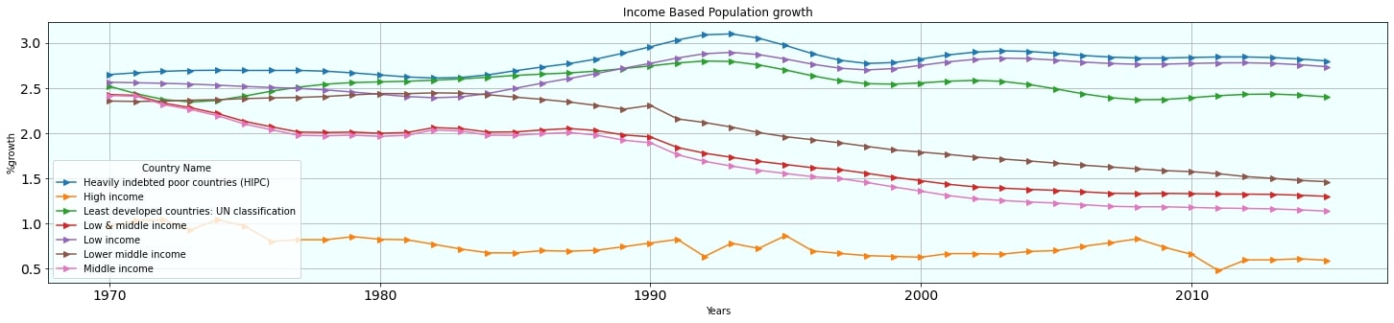
Population growth among different income groups
Inference: With the Increase in education the population growth shows a decreasing trend over the years, which is a positive trend and the population growth is almost stagnant for High income Countries and it is highest for Heavily indebted countries, again it is proved that economy, education and Social condition are highly correlated.

Slide 20
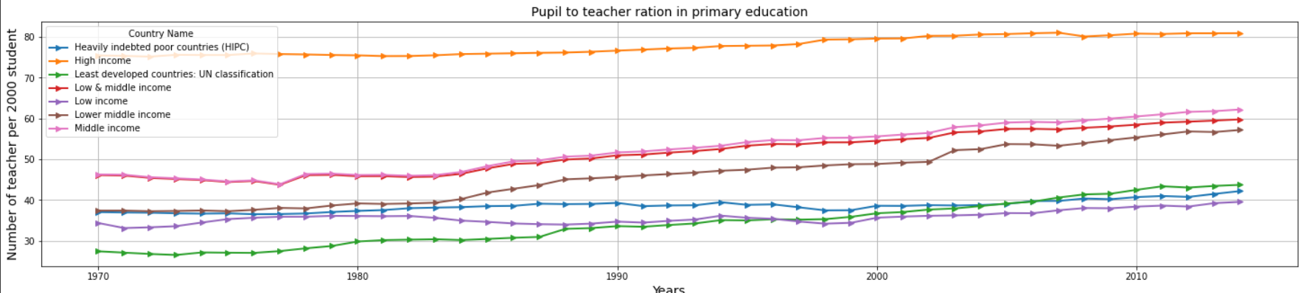
Teacher to pupil ratio, a important parameter for quality education
Inference: High Income Countries are able to provide quality education because the ratio of teacher is over 2000 students is maximum there, and it is not as per the suggested no. by world bank in Lower income countries and least developed countries, but the trend is increasing which is positive outcome.

Slide 21
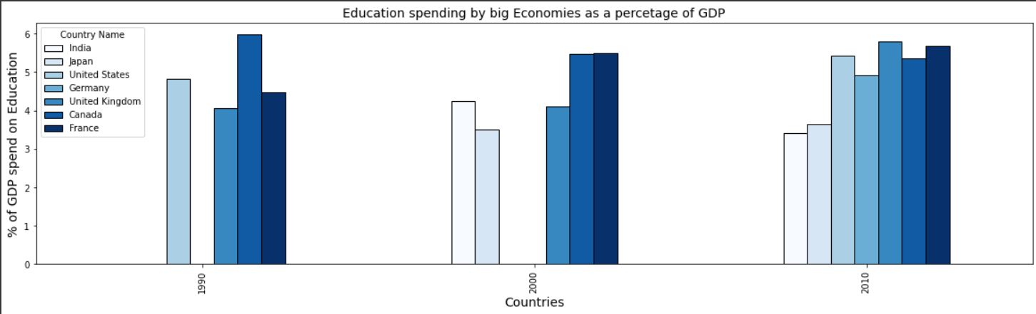
GDP analysis of World for the year 2015
Education spending by big Economies as a % of GDP
Inference: The big economies spent a big percentage of GDP on Education, hence Education is directly proportional to Development and growth of Nation.

Slide 22
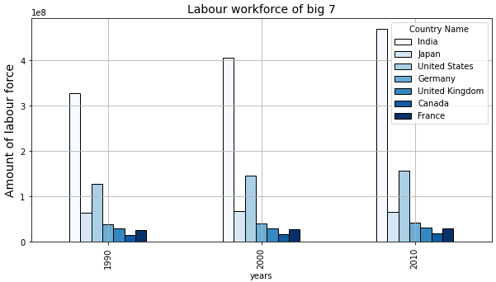
Labour Force from Big economies
Inference:- The maximum work force is available in India within World’s largest economies but per capita income is even less than mean per capita income of world which also influence lifestyle of Citizens.

Slide 23
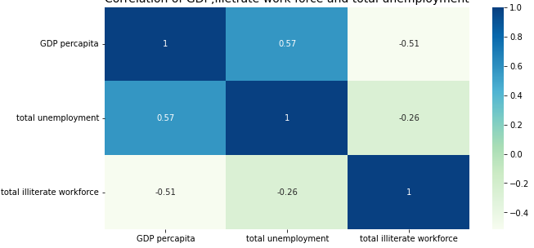
Correlation between GDP, Unemployment and illiterate labour
Inference: A skilled labour force is the building block of a nation but skills also requires education, which is directly or indirectly related to per capita GDP of that country. We can correlate GDP with various parameters. As the per Capita GDP decreases unemployment increase shows a negative correlation.

Slide 24

The economic condition of a country and region highly influence the education of that country or region.
An educated labour force always paved path to the growth and development of nation.
Increasing the spending on Education, Awareness for the enrollment on every level, Increase teacher to pupil ratio and awareness toward the population growth.

Slide 25

SUGGESTION
Awareness programmes should be incorporated in order to have a sustainable population growth
There should be more spending on education as a percentage of GDP
we must be focused towards education of children and re-education of the labor force.
we should follow the norms suggested by the world bank for Teacher to Pupil ratio.
Better data collection .

